Slide 1
KNN The K – nearest neighbours (KNN) algorithm is a simple, supervised, machine learning algorithm that can be used to solve both classification and regression problems. It is easy to implement and understand but has a drawback that significantly slows as the size of data increases.

Slide 2
KNN is highly accurate prediction
KNN algorithm at the training phase just stores the dataset and when it gets new data, then it classifies that data into a category that is much similar to the new data. Example: Suppose, we have an image of a creature that looks similar to cat and dog, but we want to know either it is a cat or dog

Slide 3
How do you use KNN for classification? KNN algorithm is used to classify by finding the K nearest matches in training data and then using the label of closest matches to predict. Traditionally, distance such as euclidean is used to find the closest match
Feature scaling is a method used to normalize the range of independent variables or features of data. In data processing, it is also known as data normalization and is generally performed during the data preprocessing step
from sklearn.preprocessing import StandardScalar
SC = StandardScalar ()
X = Sc.fit_transform(X)

Slide 4
df = pd.get_dummies(df,drop_first= True) df.head()
X = df.loc[:,['']].values
y = df.loc[:,['']].values
X
y.shape

Slide 5
from sklearn.model_selection import train_test_split X_train,X_test,y_train,y_test = train_test_split(X,y,random_state = 0, test_size = 0.25) Train/Test is a method to measure the accuracy of your model. It is called Train/Test because you split the the data set into two sets: a training set and a testing set. 80% for training, and 20% for testing. You train the model using the training set. You test the model using the testing set.
from sklearn.metrics import confusion_matrix,accuracy_score
A Confusion matrix is an N x N matrix used for evaluating the performance of a classification model, where N is the number of target classes. The matrix compares the actual target values with those predicted by the machine learning model. ... The rows represent the predicted values of the target variable.

Slide 6
from sklearn.neighbors import KNeighborsClassifier
acc_list = []
err_list = []
for i in range (1,25):
model = KNeighborsClassifier(n_neighbors=i)
model.fit(X_train,y_train)
y_pred = model.predict(X_test)
acc = accuracy_score(y_test,y_pred)
# print("For k = {}, accuracy = {}".format(i,acc))
acc_list.append(acc)
err_list.append(1-acc

Slide 7
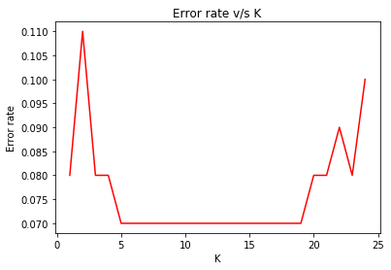
plt.plot(list(range(1,25)),err_list,c= 'r’) plt.title('Error rate v/s K’) plt.xlabel('K’) plt.ylabel('Error rate') plt.show()

Slide 8
model = KNeighborsClassifier(n_neighbors=5) model.fit(X_train,y_train) y_pred = model.predict(X_test)
confusion_matrix(y_test,y_pred)
accuracy_score(y_test,y_pred)

